Slide 1
Urban Analytics at Scale
Bill Howe
Associate Professor, Information School
University of Washington
Director, Cascadia Urban Analytics Cooperative
Notes:
NoSQL has more to do with building scalable web applications than data science and analytics.
However, it’s important to cover the topic, for a few reasons:
1) you will be manipulating data inside of these systems
2) the major systems and terms in this space are influencing people; it’s important to understand the history and trends, so you can make informed technology recommendations when you are asked
3) The same concepts we are discussing come up in this space as well.
4) Data scientists build data products, which may involve the use of these systems.

Slide 2
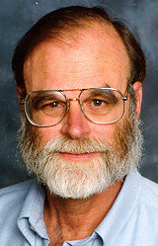


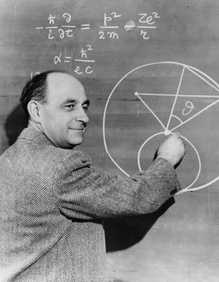



The Fourth Paradigm
Empirical + experimental
Theoretical
Computational
Data-Intensive
Jim Gray
Notes:
2

Slide 3
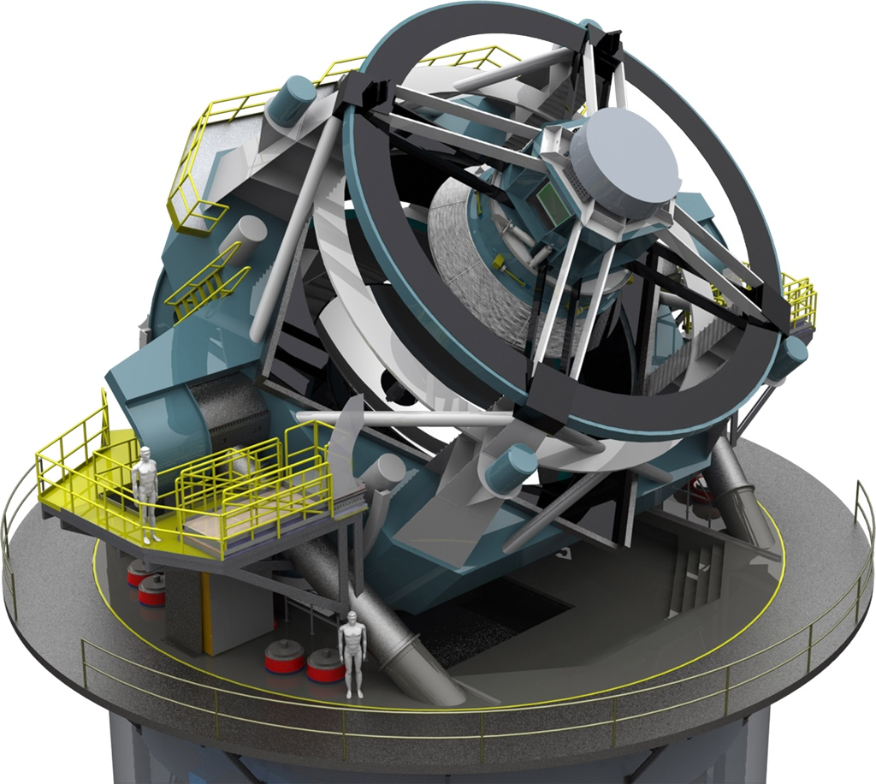


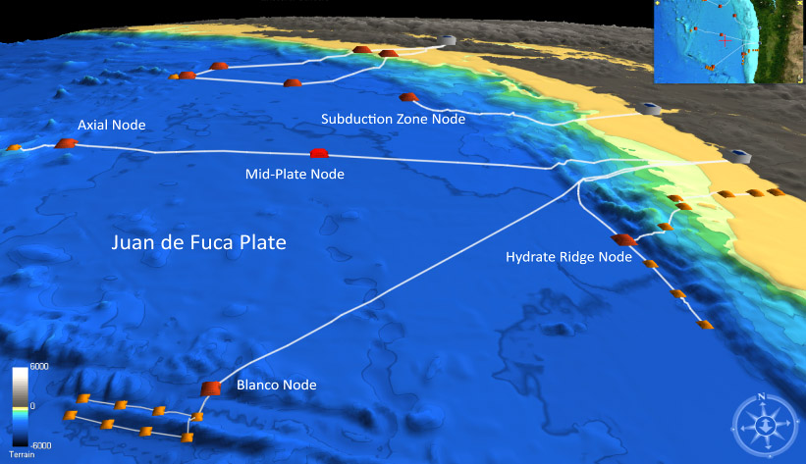
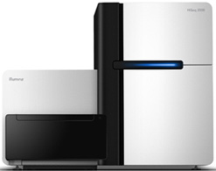
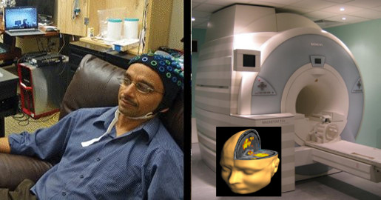
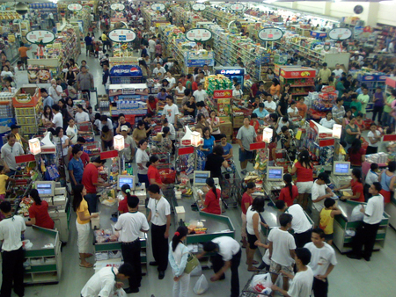
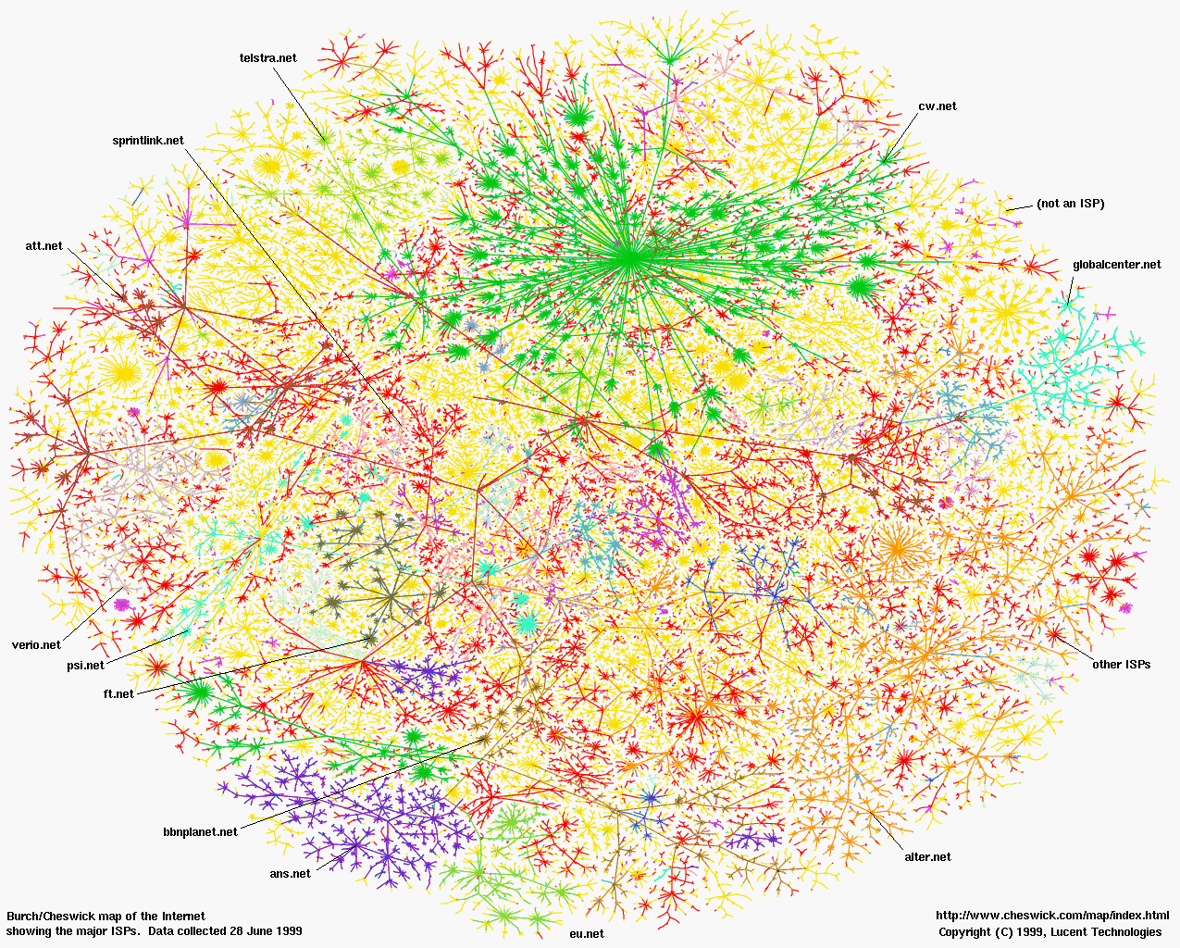
Nearly every field of discovery has been transitioning from “data poor” to “data rich”
Physics: Fermilab, LHC
Astronomy: LSST
Oceanography: OOI
Neuroscience: EEG, fMRI
Biology: Sequencing
Economics
Social Sciences
Notes:
Whether or not you subscribe to the view that this represents a fundamental shift in scientific inquiry or a different name for what had always been going on in science, there was a demonstrable change:
Nearly every field was moving from data poor to data rich, and researchers were using new methods, new tools, and asking new questions

Slide 4
SIGMOD 11, 16
CiSE 13
SSDBM 11, 14, 15
Bioinformatics 15
LLD (NIPS) 17
IJCAI 18
Weakly Structured Databases
SQLShare
ML + Curation
Astrophysics
Scalable Graph Clustering
RelaxMap
GossipMap
SC 15
TKDD 17
Earth Sciences
VizDeck
Voyager
Draco
Viziometrics
SIGMOD 12
Viz 16, 17, 18
ICPRAM 15
BigData 17
HILDA 16
Visualization Recommendation
& Viziometrics
Biomedicine
Polystores /
Big Data Systems
HaLoop
Myria
VLDB 10, 13, 15
SOCC 10
SIGMOD 12, 14
CIDR 17
DAMON 17
Social Sciences
Responsible Data Science
Fides
Synth. Data
SSDBM 17
D4GX 17
BiDU 18
SIGMOD 19
Notes:
Throughout that time, I held an affiliate faculty position in Computer Science & Engineering, and maintained a portfolio of grants and a team of 5-8 students and postdocs.
So we’d identify recurring problems across fields of science, find appropriate abstractions, and solve them.
We did a lot of work in Big Data Systems, in particular around the idea that you need to wire together different systems with different capabilities to be competitive.
We did some algorithmic work in scalable graph clustering, using better methods from the network science and physics community, but scaling them up with approximate distributed algorithms.
Visualization has grown explosively in the last decade; our focus has been on automating parts of the process to keep up with. Data complexity.
Throughout this period, we kept encountering big collections of what I call weakly structured datasets. They tend to be semantically coherent – surveys, mass spec experiments, gene expression experiments. And they may have some common formats – rows and columns, or one of a few vendor-specific file types for the sensor or assay that produces them. But other than that, all bets are off. The metadata is extremely heterogeneous, making them difficult to integrate. So we developed some systems and methods to make sense of these early “data lakes”
In this talk, I want to talk about some very recent work in this space around automatically verifying scientific claims over these kind of weakly structured repositories.

Slide 5
Today…
SIGMOD 11, 16
CiSE 13
SSDBM 11, 14, 15
Bioinformatics 15
LLD (NIPS) 17
IJCAI 18, 19 (review)
VLDB 19 (review)
Weakly Structured Databases
SQLShare
ML + Curation
Astrophysics
Scalable Graph Clustering
RelaxMap
GossipMap
SC 15
TKDD 17
Earth Sciences
VizDeck
Voyager
Draco
Viziometrics
SIGMOD 12
Viz 16, 17, 18
ICPRAM 15
BigData 17
HILDA 16
Visualization Recommendation
& Viziometrics
Biomedicine
Polystores /
Big Data Systems
HaLoop
Myria
VLDB 10, 13, 15
SOCC 10
SIGMOD 12, 14
CIDR 17
DAMON 17
Social Sciences
Responsible Data Science
Fides
Synth. Data
SSDBM 17
D4GX 17
BiDU 18
FAT* 18
SIGMOD 19
Notes:
Throughout that time, I held an affiliate faculty position in Computer Science & Engineering, and maintained a portfolio of grants and a team of 5-8 students and postdocs.
So we’d identify recurring problems across fields of science, find appropriate abstractions, and solve them.
We did a lot of work in Big Data Systems, in particular around the idea that you need to wire together different systems with different capabilities to be competitive.
We did some algorithmic work in scalable graph clustering, using better methods from the network science and physics community, but scaling them up with approximate distributed algorithms.
Visualization has grown explosively in the last decade; our focus has been on automating parts of the process to keep up with. Data complexity.
Throughout this period, we kept encountering big collections of what I call weakly structured datasets. They tend to be semantically coherent – surveys, mass spec experiments, gene expression experiments. And they may have some common formats – rows and columns, or one of a few vendor-specific file types for the sensor or assay that produces them. But other than that, all bets are off. The metadata is extremely heterogeneous, making them difficult to integrate. So we developed some systems and methods to make sense of these early “data lakes”
In this talk, I want to talk about some very recent work in this space around automatically verifying scientific claims over these kind of weakly structured repositories.

Slide 6
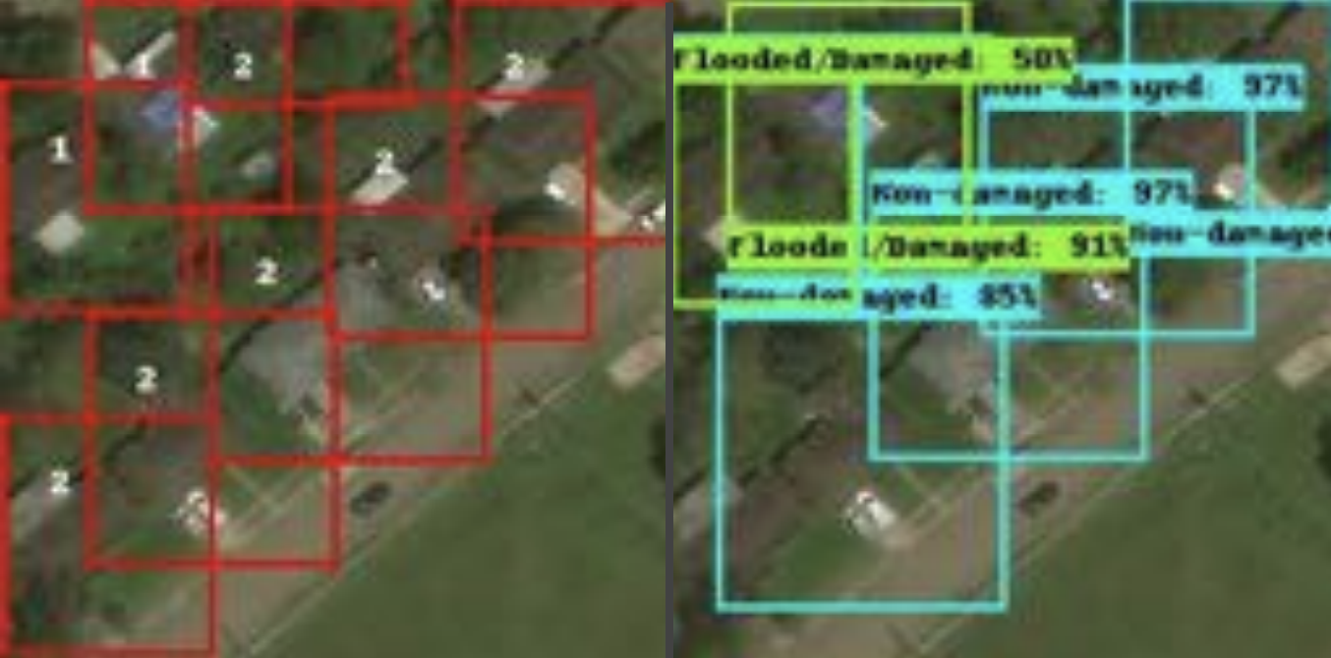
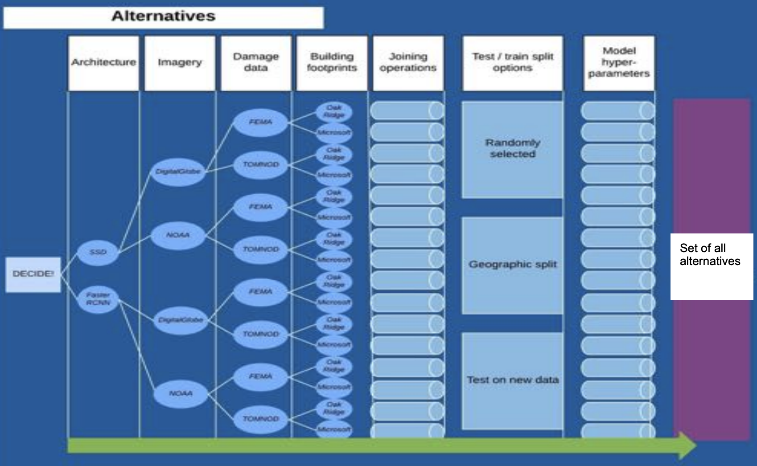
Detecting flood-damaged buildings from satellite imagery using neural networks
Youngjun Choe

Slide 7
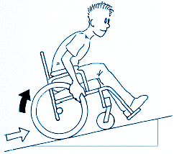
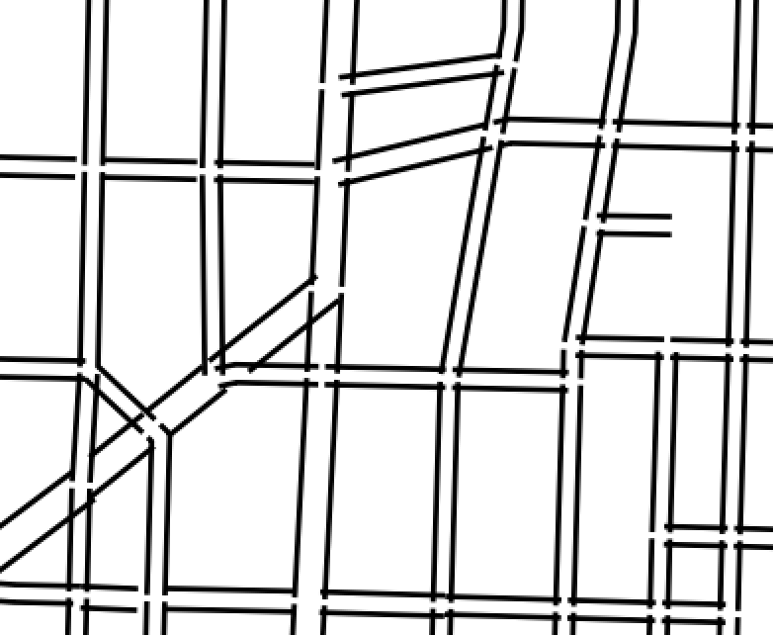
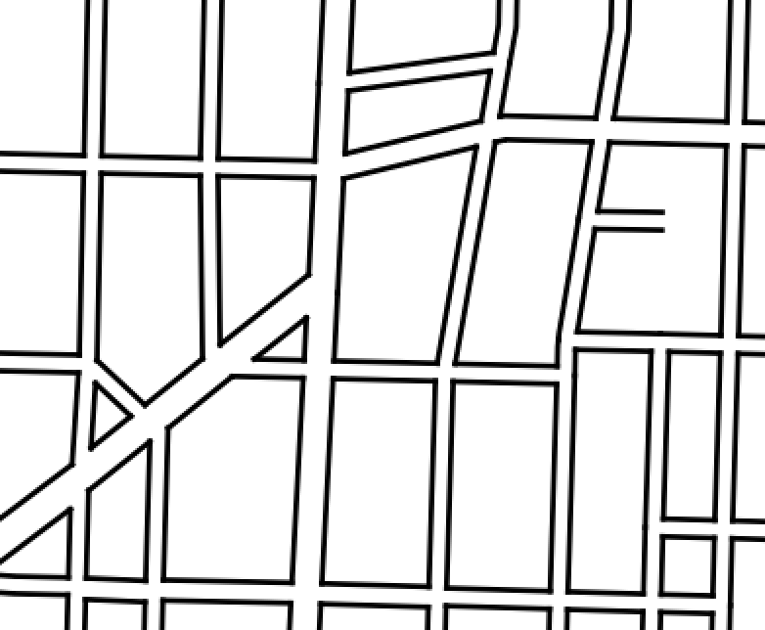
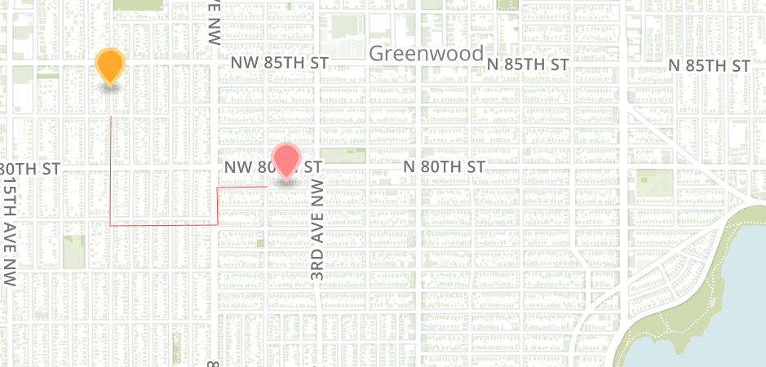
Accessibility, Urban Mobility
powered by data from:
SDOT/Socrata, Google API
Anat Caspi

Slide 8







Housing and homelessness
Transitional housing
Rapid
re-housing
Permanent housing
Emergency shelter
Housing with services
Unsuccessful exit

Slide 9
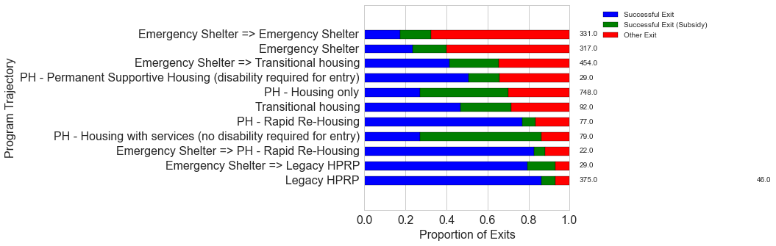
Data: Pierce County
Analyzing Family Trajectories through Programs
Emergency Shelter -> Transitional Housing
Only 40% successful exits
Emergency Shelter -> Rapid Re-housing
80% successful exits
Common trajectories lead to different outcomes:
a successful exit from an episode would mean that the family found a permanent housing solution
a proportion of these still receive government subsidies
other exits are exits back into homelessness, or to other, unknown destinations

Slide 10
City agency
Subject matter experts
Data scientists
Notes:
Subject matter experts and data experts used to be the same people, or at least both worked closely together.

Slide 11
City agency
Subject matter experts
Data scientists
Notes:
But as the methods became more advanced, people became more specialized, and distance between subject matter experts and analysis experts increased

Slide 12
City agency
Subject matter experts
Data scientists
Notes:
And now it’s common for the analysts to have popped out of the organization altogether – vendors, research teams, consultants

Slide 13
City agency
data
context
Notes:
So the subject matter experts need to pass data to the analysts.
Analysts need data to even begin to help.
It’s (technically) easy to hand over data. But wehat is harder to deliver?
Context.
Analyze bus route patterns: We found an anomaly of low ridership over a three-day period. “Ya, it was a snow day”

Slide 14
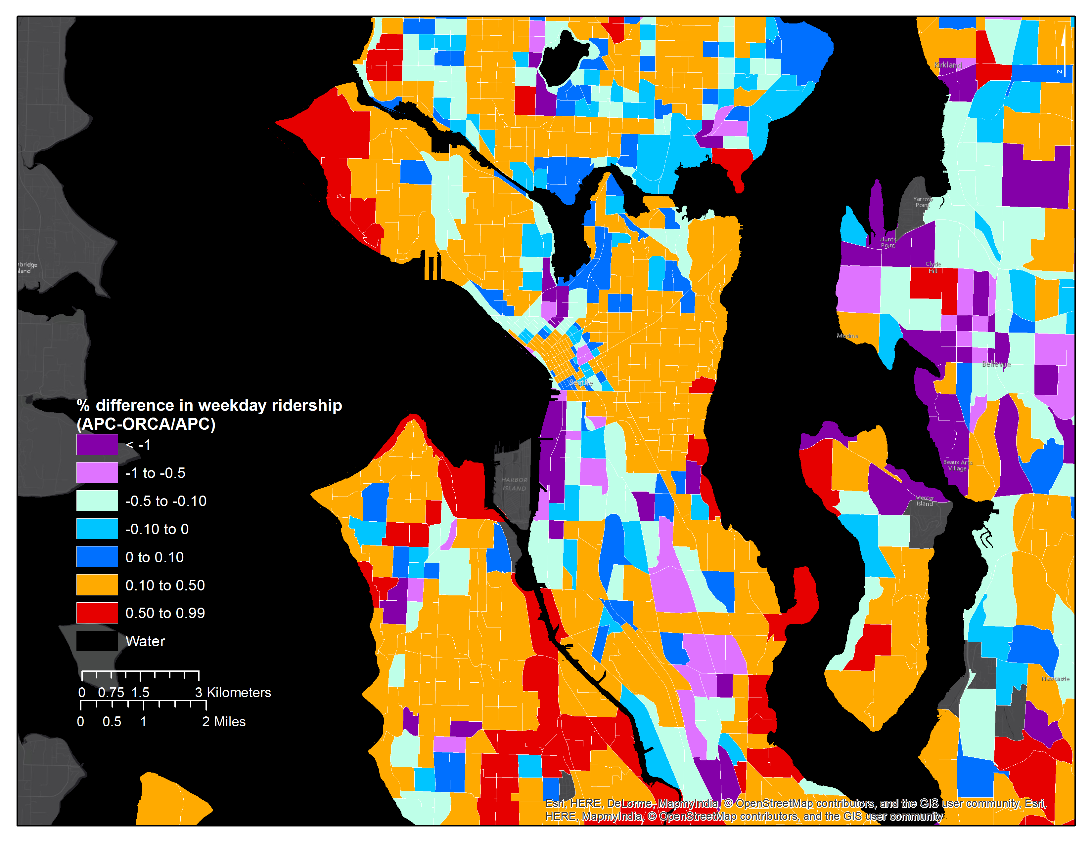

Context is important: ORCA Percentage Difference in Ridership, Seattle
Mark Hallenbeck
TRAC

Slide 15
Today
Part 1: Responsible Data Sharing
Privacy
Fairness
Part 2: Neural Methods for Urban Data
Deep Learning Review
NN in Urban Contexts
Hands-On
Exercise: Semi-Synthetic Data
Exercise: LSTMs for RideShare Prediction
First class requirements in the public sector!

